Slide 1
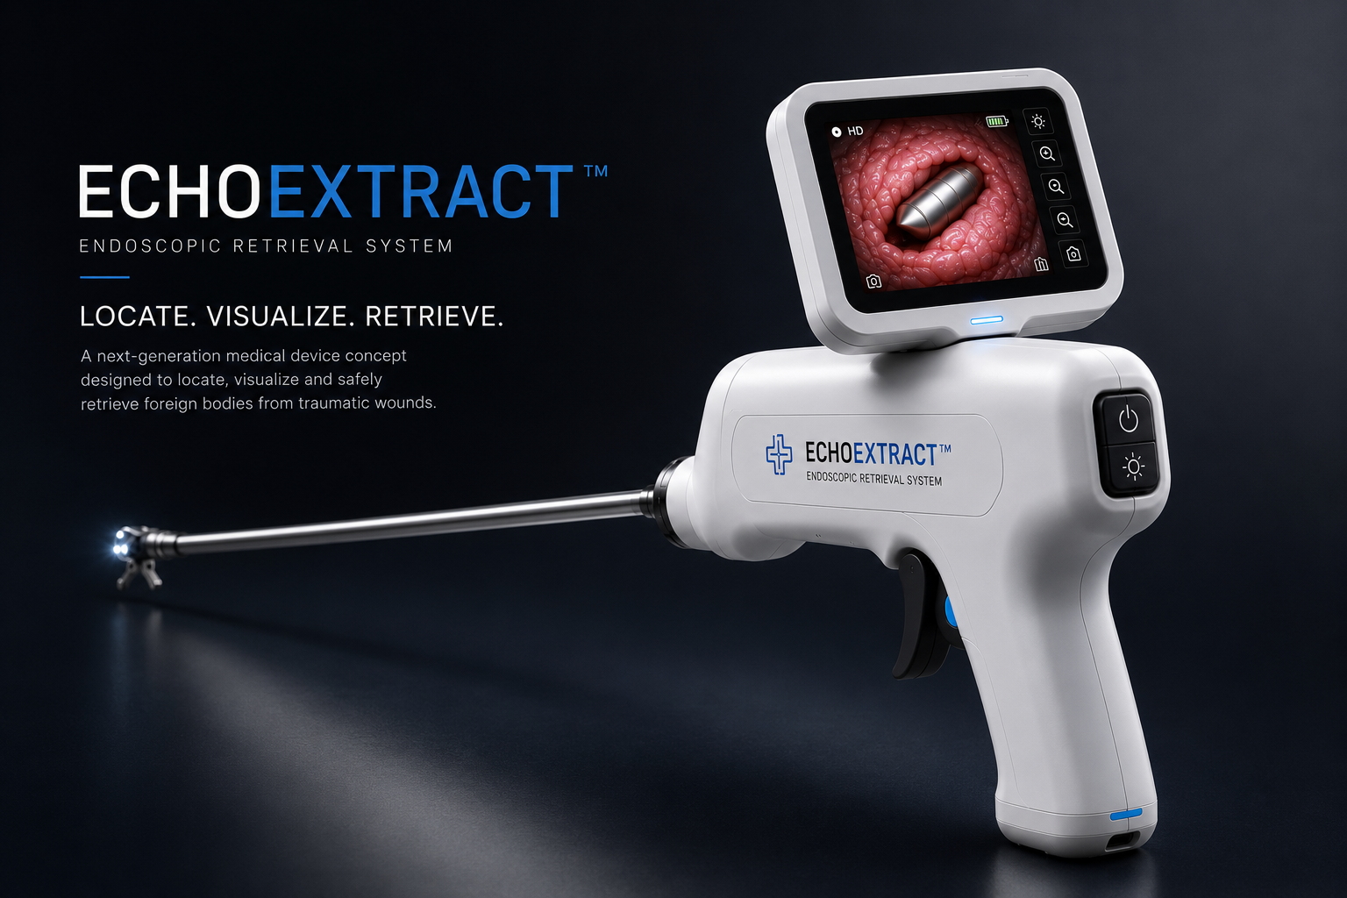
01 | ECHOEXTRACT™ | Confidential concept-stage investor material

Slide 2
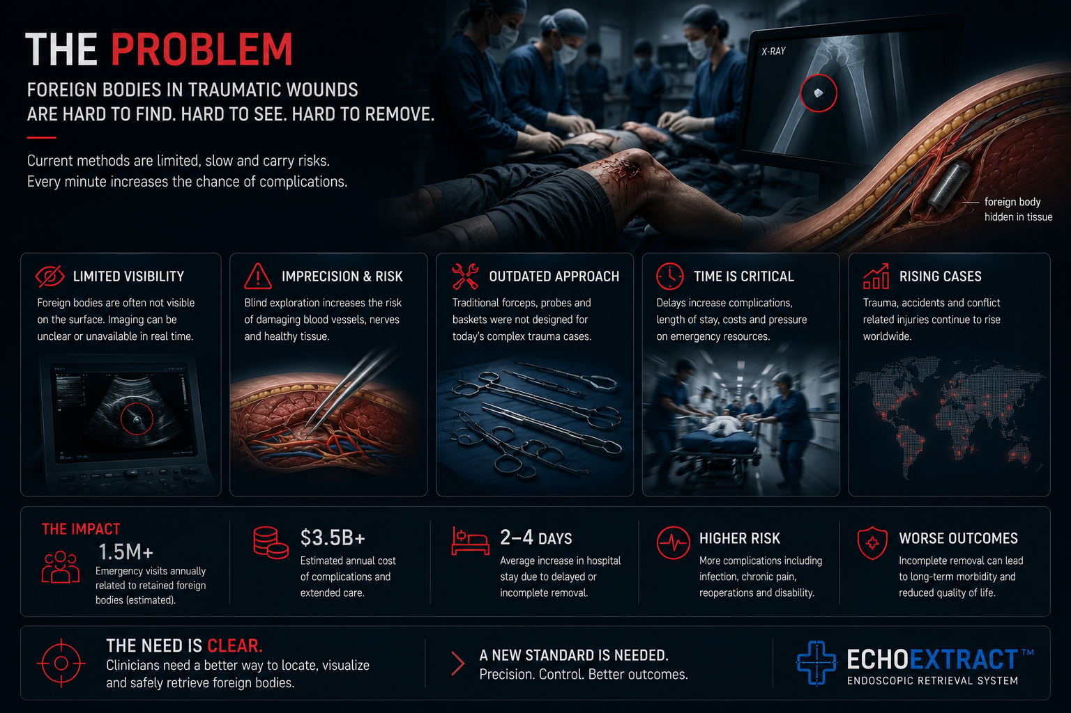
E
ECHOEXTRACT™
INVESTOR DECK
THE PROBLEM
The risk is not retrieval. The risk is blind retrieval.
Foreign bodies embedded in traumatic wounds can be difficult to see, localize and remove safely. Current workflows may be fragmented between imaging, lighting, retrieval tools and clinical decision-making under time pressure.
Limited visibility in soft tissue wounds
Fragmented workflow across separate tools
Time pressure in trauma and emergency environments
Clinical and regulatory risk must be validated before use
02 | ECHOEXTRACT™ | Confidential concept-stage investor material

Slide 3
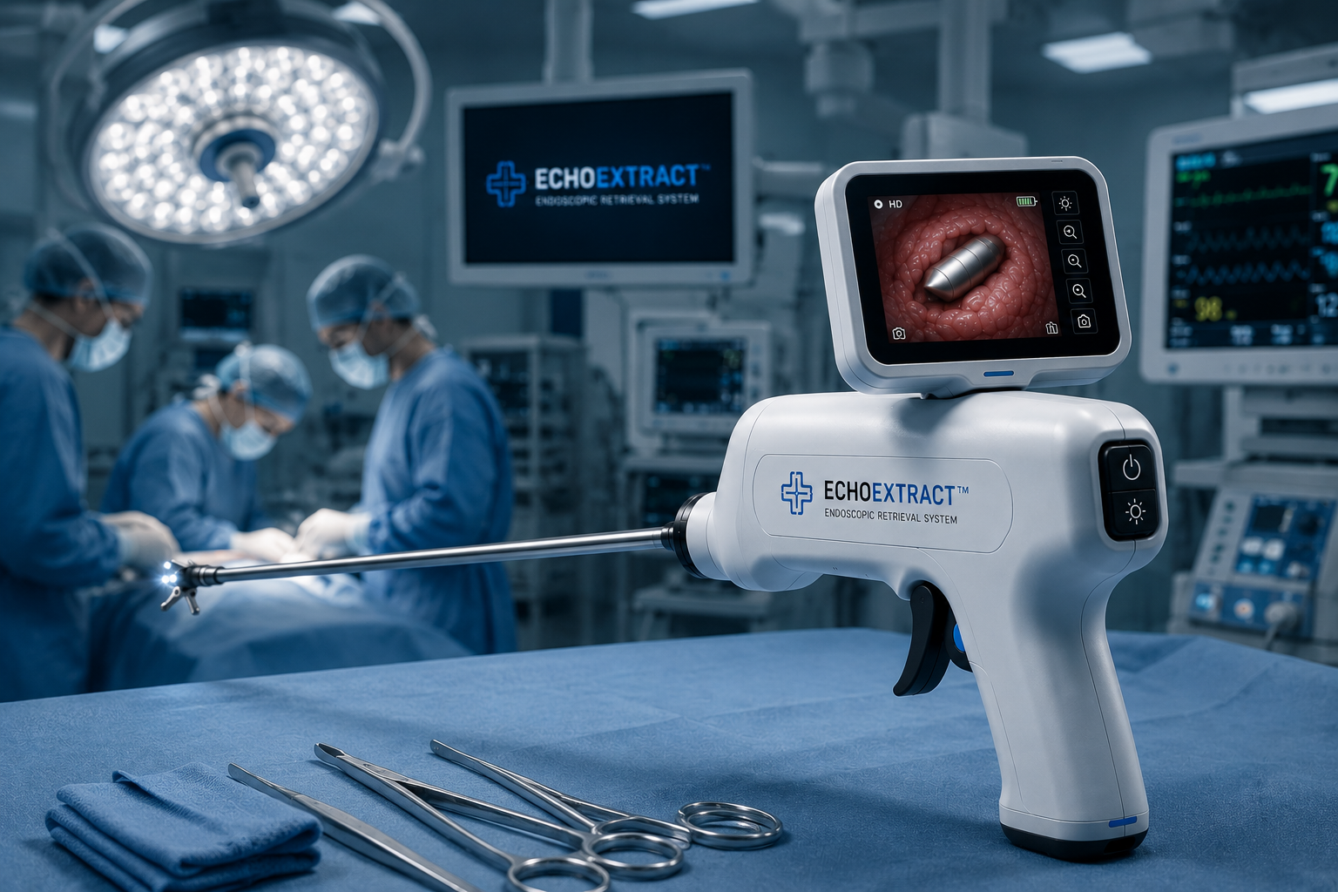
E
ECHOEXTRACT™
INVESTOR DECK
WHY NOW
Portable medical hardware is moving toward smaller, smarter systems.
Miniaturized imaging, portable displays, modular instruments and emergency-care innovation create a realistic opportunity to explore compact image-guided retrieval systems.
Endoscopy
Trauma care
Field medicine
Established category
Workflow pressure
Portable need
Opportunity area: endoscopic devices + trauma care + emergency medicine + field medicine + surgical visualization.
03 | ECHOEXTRACT™ | Confidential concept-stage investor material

Slide 4
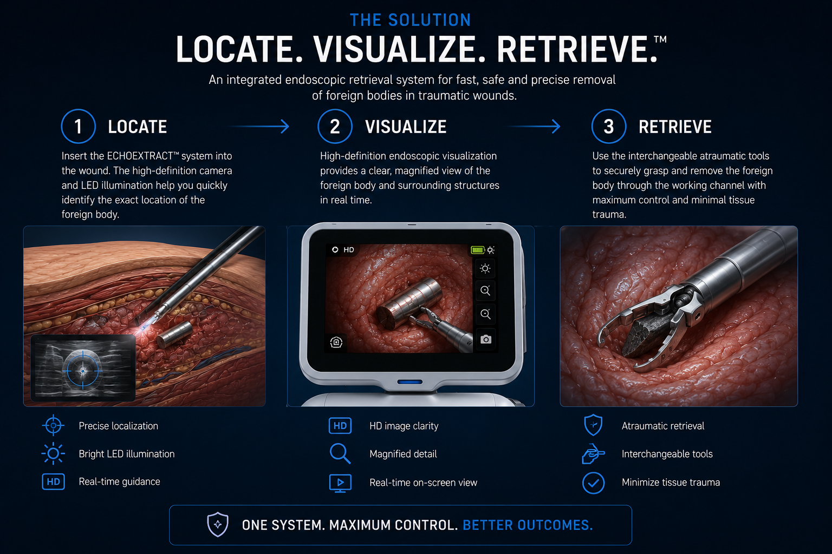
E
ECHOEXTRACT™
INVESTOR DECK
THE SOLUTION
One workflow. Three critical actions.
ECHOEXTRACT™ is positioned around a simple product hypothesis: combine visualization, illumination and controlled retrieval into one portable concept-stage platform.
Locate the foreign body in a trauma-focused workflow
Visualize through an integrated camera and display
Retrieve under control using modular retrieval tips
04 | ECHOEXTRACT™ | Confidential concept-stage investor material

Slide 5
E
ECHOEXTRACT™
INVESTOR DECK
PRODUCT CONCEPT
A handheld system concept, not a finished medical device.
The current presentation defines the product direction: white medical body, integrated LCD, surgical shaft, HD imaging, LED illumination, working channel and modular retrieval tips. Final mechanics require engineering validation.
Integrated LCD concept
50 cm working shaft concept
HD camera + LED illumination
Modular retrieval tips
Portable kit architecture
05 | ECHOEXTRACT™ | Confidential concept-stage investor material

Slide 6
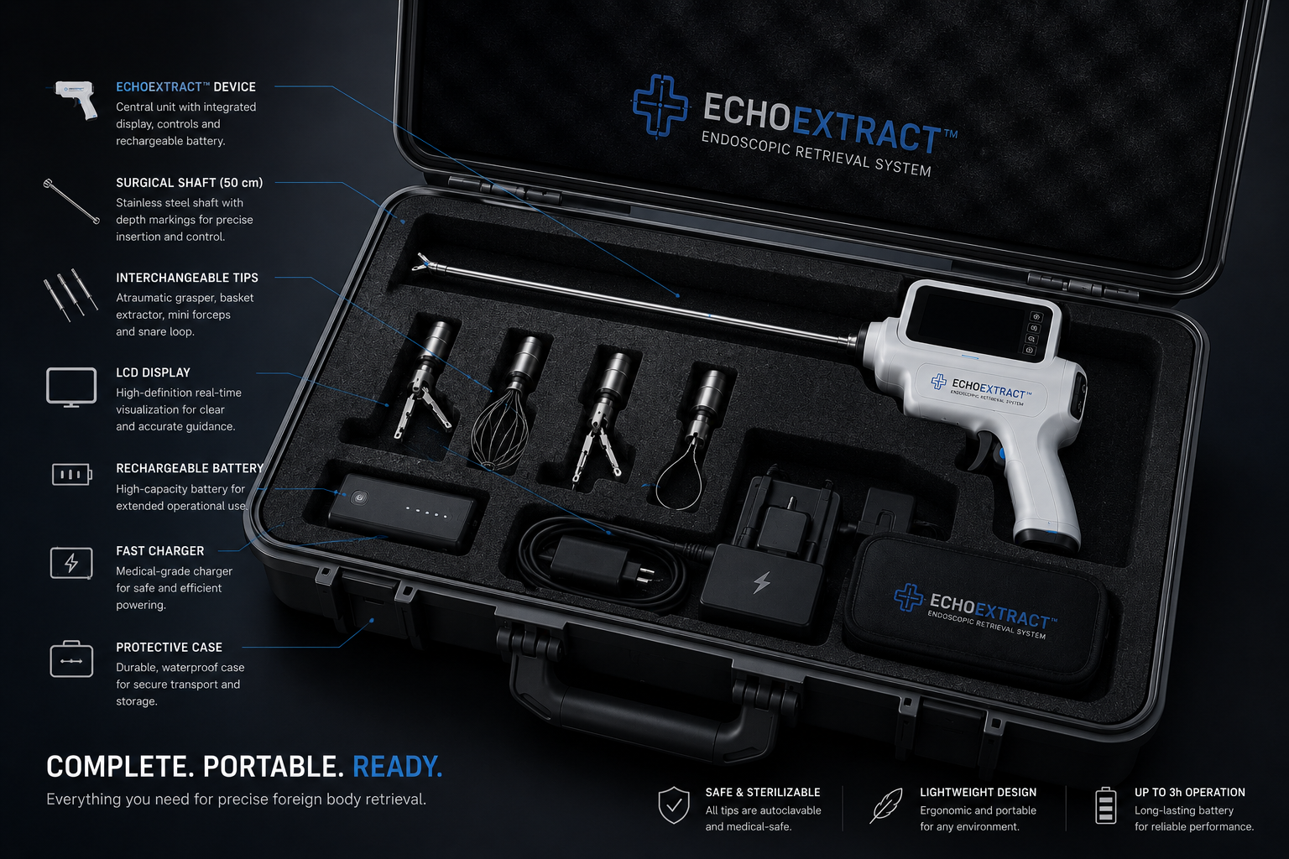
E
ECHOEXTRACT™
INVESTOR DECK
CURRENT STATUS
Where the project stands today.
ECHOEXTRACT™ has a defined concept, visual direction and investor narrative. It now requires capital, engineering execution and medical consultation.
Concept developed
Pre-prototype stage
Core product logic, visual identity and investor narrative are defined.
The device is not yet built, certified or clinically validated.
First milestone
Capital required
Functional bench prototype with camera, LED, LCD interface and retrieval mechanism.
Funding and specialist partners are required for engineering, testing and regulatory planning.
06 | ECHOEXTRACT™ | Confidential concept-stage investor material

Slide 7
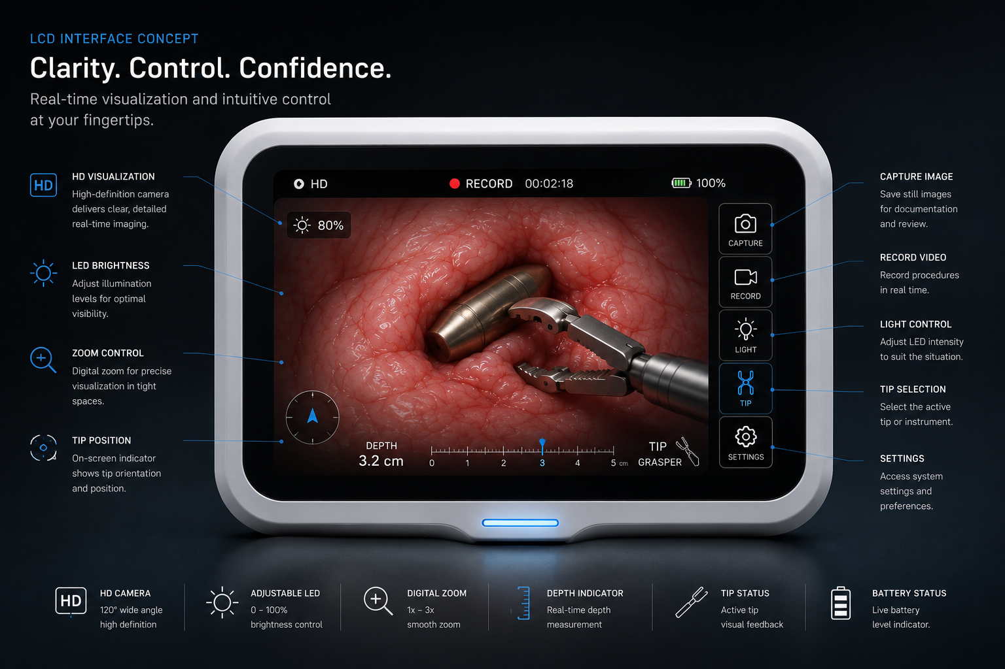
E
ECHOEXTRACT™
INVESTOR DECK
PROTOTYPE DEMO VISION
The first prototype must prove the core experience.
The immediate technical goal is a functional bench prototype that demonstrates the most important assumptions before any clinical claims are made.
Live camera feed on LCD
LED illumination control
Shaft handling and orientation
Working-channel retrieval mechanism
Controlled retrieval simulation on synthetic tissue models
07 | ECHOEXTRACT™ | Confidential concept-stage investor material

Slide 8
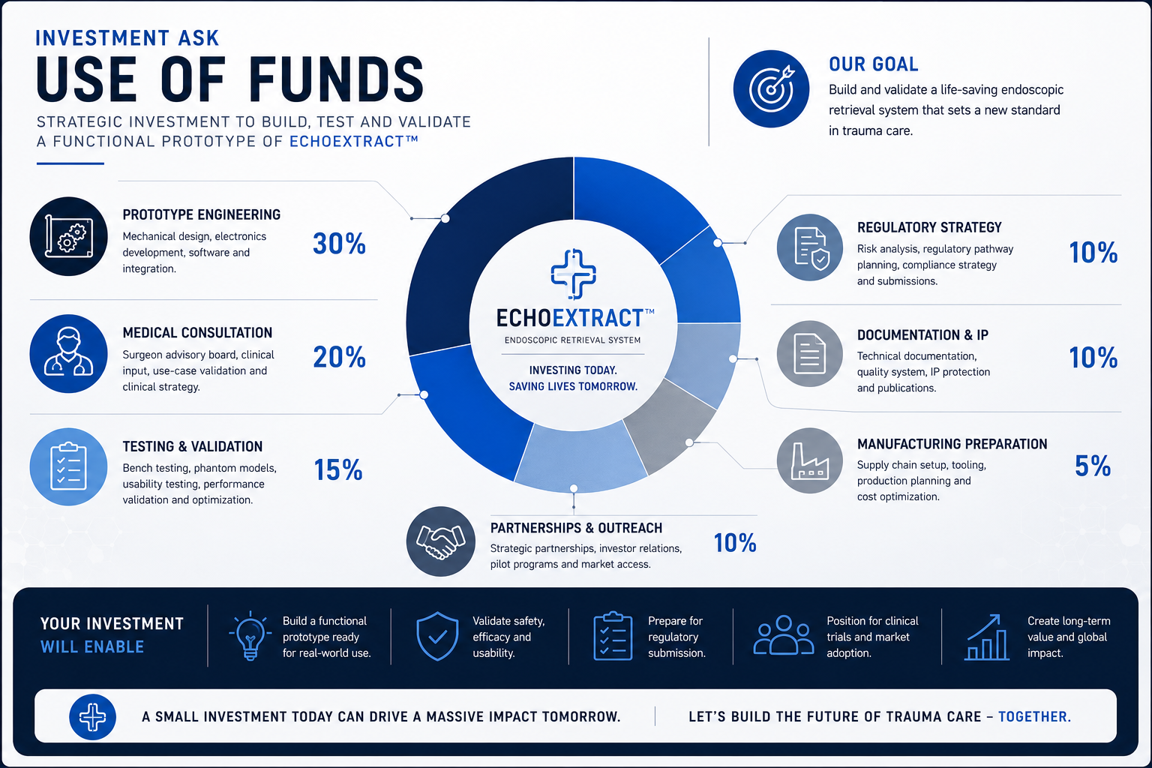
E
ECHOEXTRACT™
INVESTOR DECK
DE-RISKING PLAN
The investment path should reduce risk milestone by milestone.
The first capital should not be used to claim clinical readiness. It should fund validation of assumptions and development of a functional bench prototype.
Clinical need validation with medical advisors
Optics and visibility testing
Tip mechanics and retrieval control
Synthetic tissue model testing
Regulatory classification review
IP and documentation strategy
08 | ECHOEXTRACT™ | Confidential concept-stage investor material

Slide 9
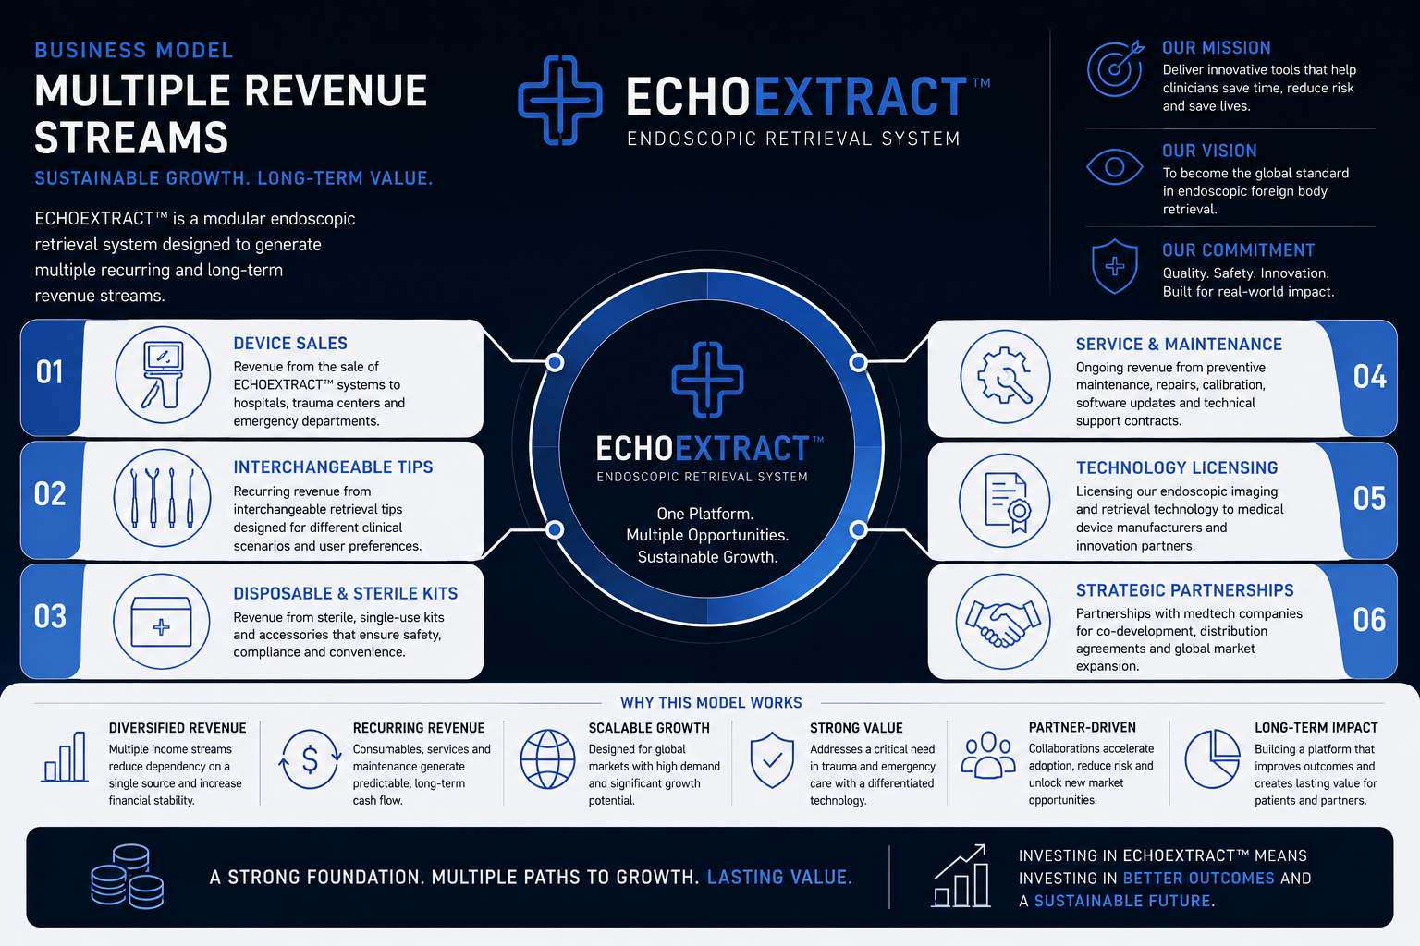
E
ECHOEXTRACT™
INVESTOR DECK
BUSINESS MODEL
Multiple revenue streams. One medtech platform.
The long-term model can extend beyond device sales into recurring tips, sterile kits, service, training, licensing and strategic partnerships.
09 | ECHOEXTRACT™ | Confidential concept-stage investor material

Slide 10
E
ECHOEXTRACT™
INVESTOR DECK
INVESTMENT ASK
Capital should fund a disciplined prototype and validation path.
Funding should be tied to concrete milestones: engineering, medical consultation, testing, regulatory strategy, documentation and partner development.
10 | ECHOEXTRACT™ | Confidential concept-stage investor material

Slide 11
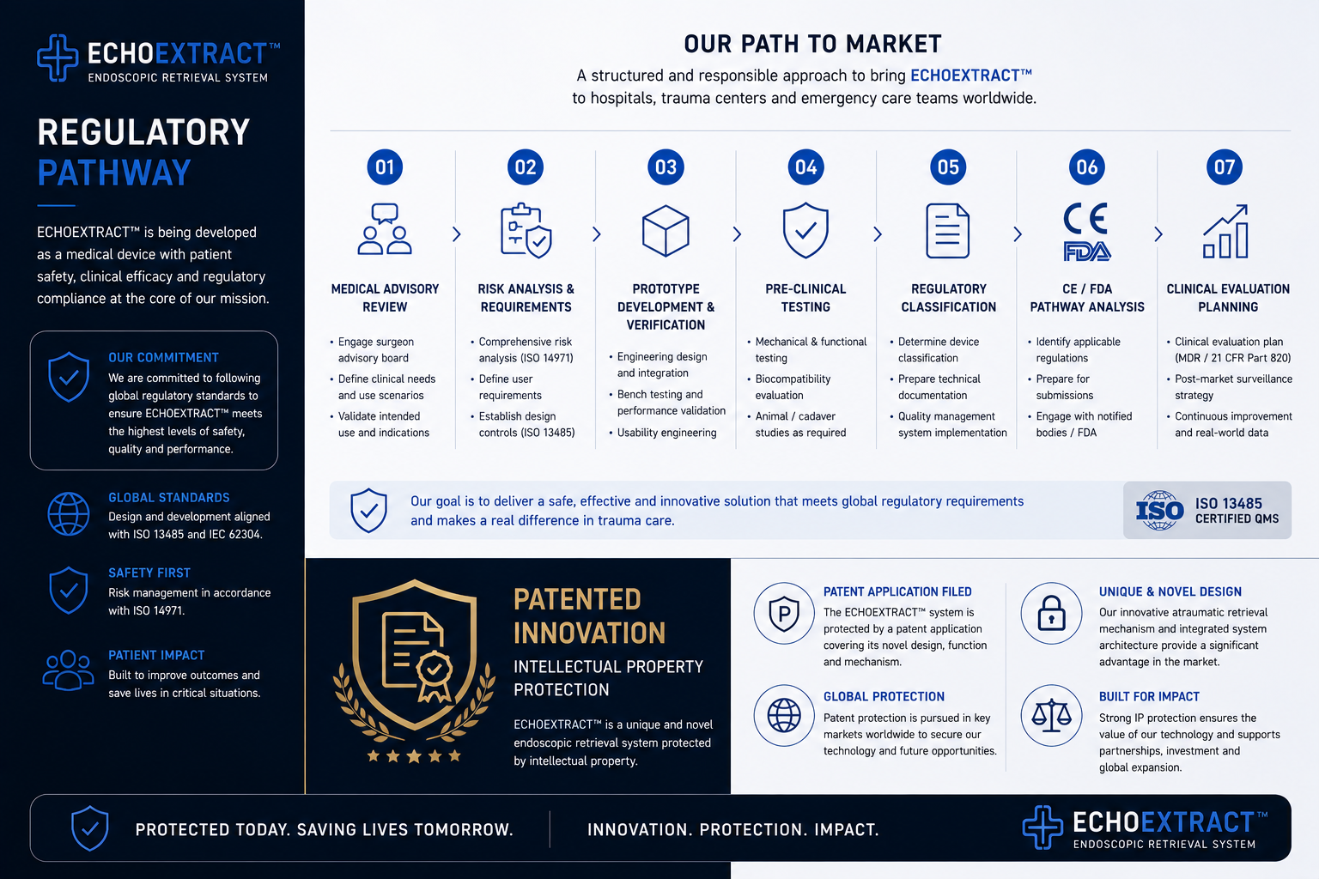
E
ECHOEXTRACT™
INVESTOR DECK
REGULATORY + IP
Credibility depends on responsible medical-device development.
ECHOEXTRACT™ is not yet approved, certified or validated for patient use. Any future device requires medical review, engineering validation, risk management and regulatory clearance before clinical deployment.
Regulatory classification research
Risk analysis and quality documentation
Prototype validation plan
Patent / IP filing strategy
CE / FDA pathway analysis with specialists
11 | ECHOEXTRACT™ | Confidential concept-stage investor material

Slide 12
E
ECHOEXTRACT™
INVESTOR DECK
VALUE CREATION
Future routes may include licensing, co-development or acquisition discussions.
A validated functional prototype could create strategic value for companies operating in endoscopy, trauma care, emergency medicine, field medicine or medical visualization.
Licensing
Co-development
Acquisition
Established medtech players
Engineering and clinical partners
After milestone validation
12 | ECHOEXTRACT™ | Confidential concept-stage investor material

Slide 13
E
ECHOEXTRACT™
INVESTOR DECK
FOUNDER + CURRENT NEED
Created by Adam Adamski. Built for serious development with the right partners.
Adam Adamski is an independent concept creator focused on practical technologies for safety, emergency response and human survival. ECHOEXTRACT™ is currently seeking strategic investors, medical advisors and engineering partners.
Capital for functional bench prototype
Medical advisory from trauma and emergency experts
Engineering partner for optics, mechanics and interface
Regulatory and IP specialists for pathway planning
13 | ECHOEXTRACT™ | Confidential concept-stage investor material

Slide 14
E
ECHOEXTRACT™
INVESTOR DECK
NEXT STEP
Start the investor conversation.
ECHOEXTRACT™ is a concept-stage opportunity. The immediate goal is not commercial deployment. It is to build and validate a functional bench prototype with the right medical, engineering and investment partners.
Request the private investor deck
Discuss NDA access and prototype partnership
Review medical advisory and engineering roadmap
Explore investment, licensing or co-development options
Contact: Adam Adamski
Project: ECHOEXTRACT™ | Concept-stage medtech platform
14 | ECHOEXTRACT™ | Confidential concept-stage investor material

